Slide 1
Portfolio
Caitlin Watson-Beaton
@watsbeaton

Slide 2
Brainstorming
(aka the thing I did way too much of)
Tuesday…Wednesday…Thursday…Friday…and, finally…an IDEA!

Slide 3
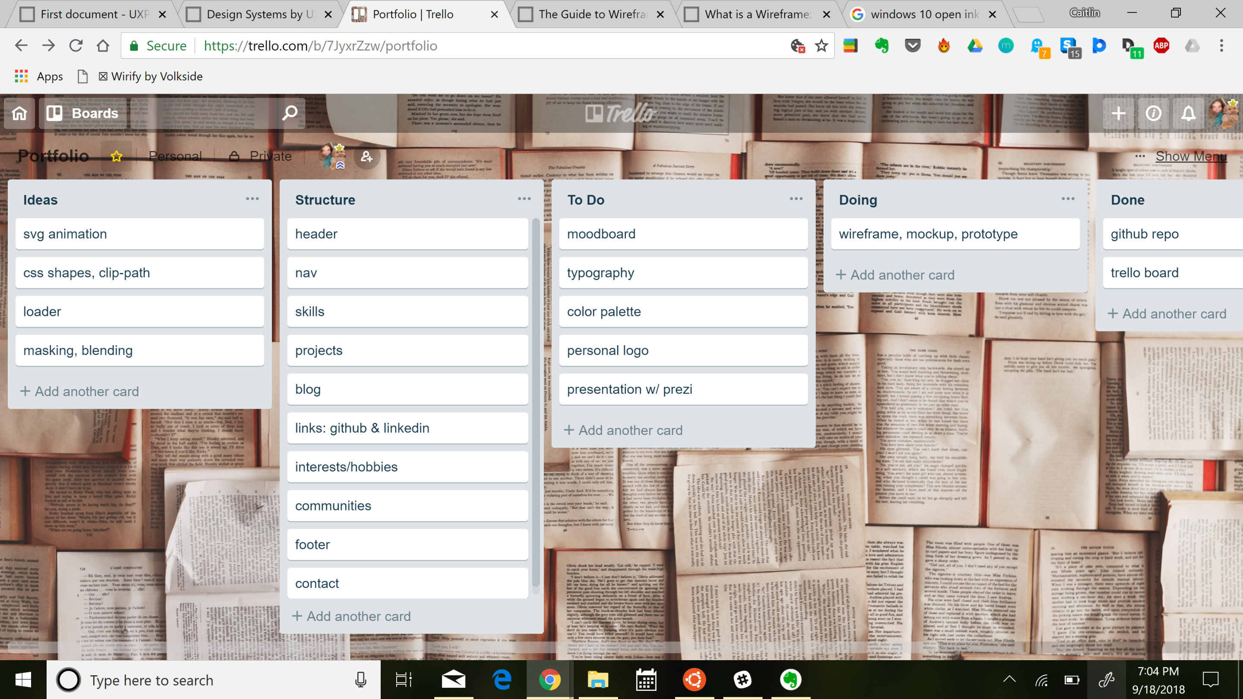
Turns out there’s more to project management than making a trello board & a github repo.

Slide 4
“What cool things can I do with pure CSS?”
CSS Grid & Shapes! Empowering devs to get more creative with web layouts – go beyond the typical box layout (header, main, sidebar, footer, bleh).
Watched a lot of videos by Jen Simmons; learned about the history of layouts. We’re entering a shiny new era where it’s possible for devs to bring the tradition of editorial design (think magazines) to web design.
Considered page transitions & animations.
Attracted to “cover sheet” headers that take up the full viewport height (viewport units are the best). Want to stack content (text) over a full-bleed image.
I learned about progressive enhancement

Slide 5
Inspiration: Storytelling & Adventure
Storybook-style modals that slide in right, like a turning pages.
Botanical typography (illustrative) & drop caps
Personal logo & “Full-Stack Developer” rotated on a downward slant
Dark UI (deep purple): to suggest imagination, mystery, intellect, complexity, power etc.
Literary pull quotes overlaid onto grid
Pen-&-ink fairytale icons, e.g. chipped teacup, scattered amongst the grid items (decorative, hover effects).
Full-screen overlay nav menu w/ roman numerals for links (like book chapters), e.g. I About II Projects IV Contact.
OMG it’s due in two days!!! What are you thinking????? Keep it SIMPLE (too late…)

Slide 6
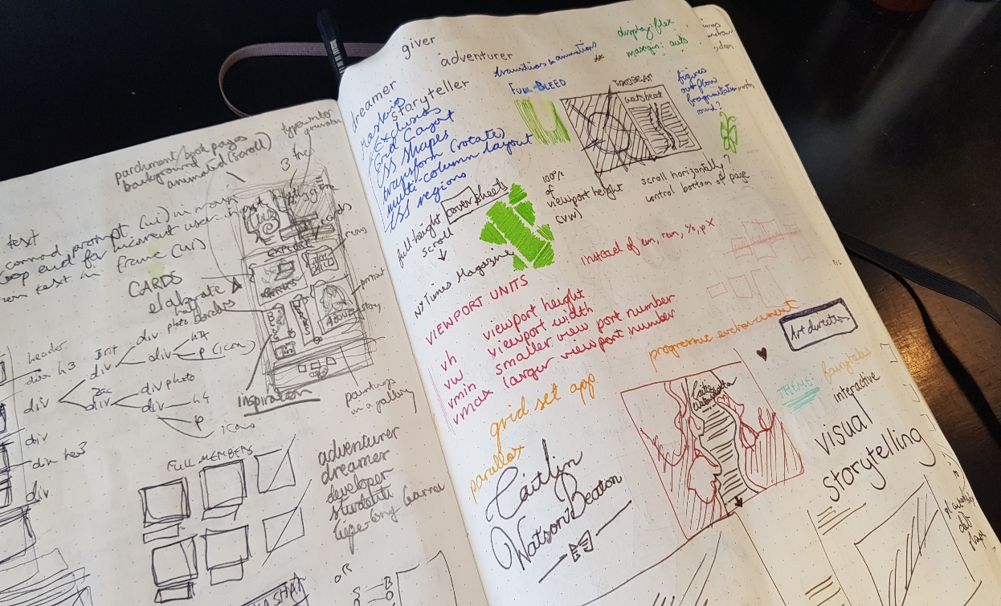
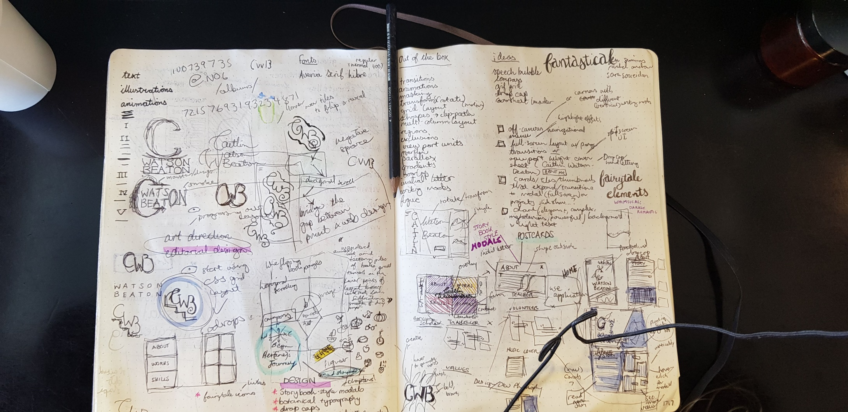
Wireframing & Mood-boarding

Slide 7
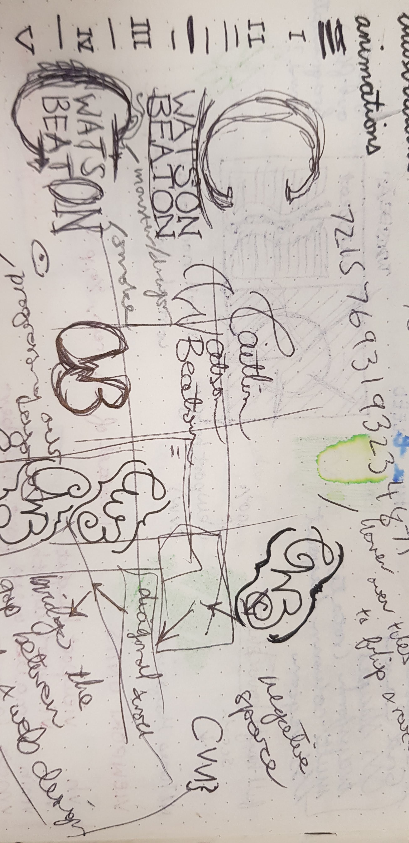
Double-barrel Dilemma: Staircase Logo

Slide 8
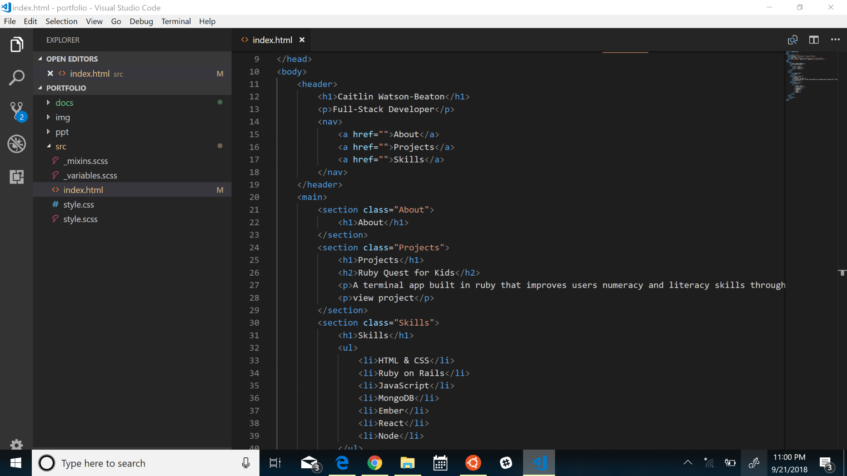
In the beginning, there was clean code…

Slide 9
But, it grew big & messy.
I had to scrap it ☹

Slide 10
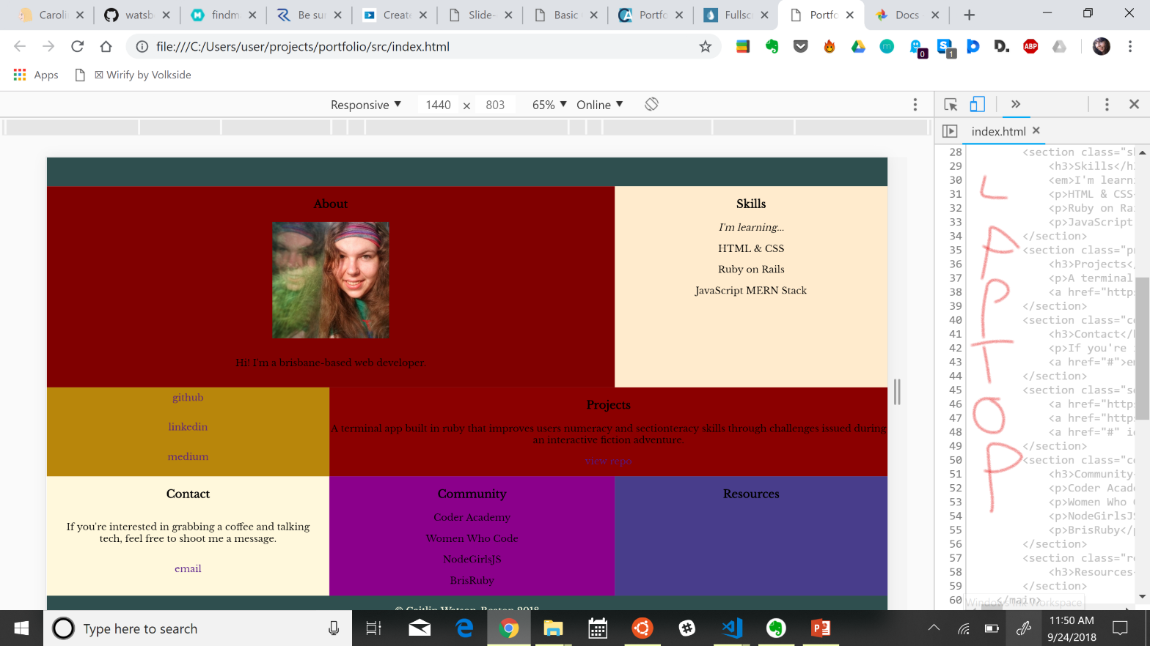
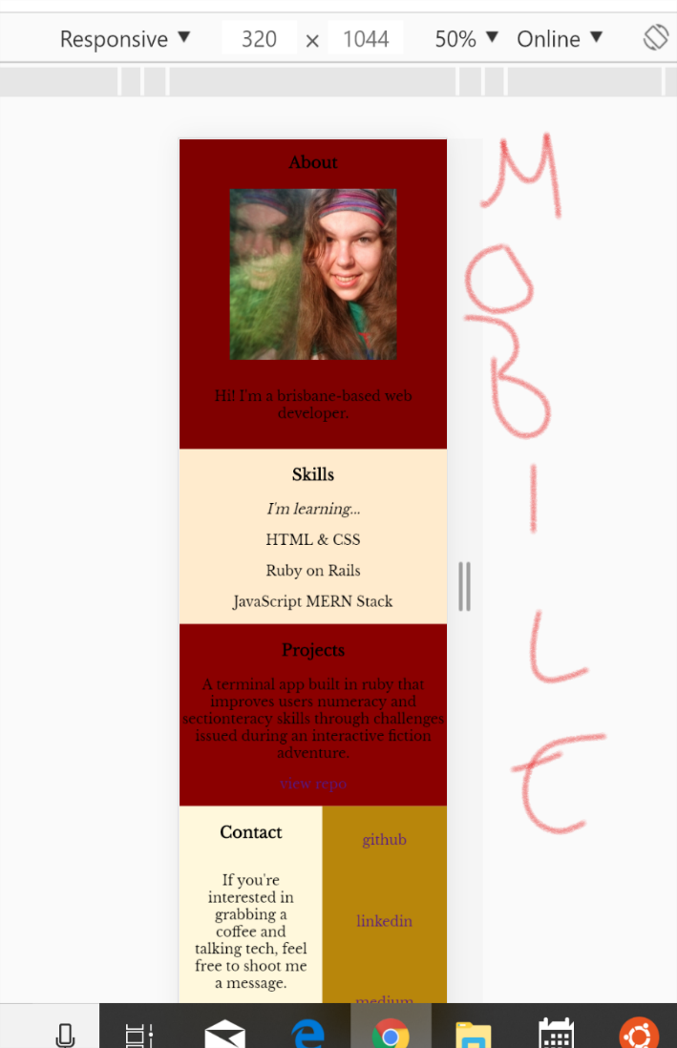
Usability & Accessibility
Responsive layout using grid-areas & media queries:
Mobile: mostly single-column
Wider: multi-columns
Attempted to include screen-reader stuff, but it got scrapped with the original code.
Growth mindset:
It can always get better ;)

